Slide 1
Digital portfolio
STUDENT NAME : V PAVITHRA
REGISTER NO AND NMID : B1C48FFC17ADD52B21A4CE197CB32C03
DEPARTMENT : BCA [computer applications]
COLLEGE : Sri Bharathi Women’s Arts and Science College
UNIVERSITY : Thiruvalluvar University

Slide 2
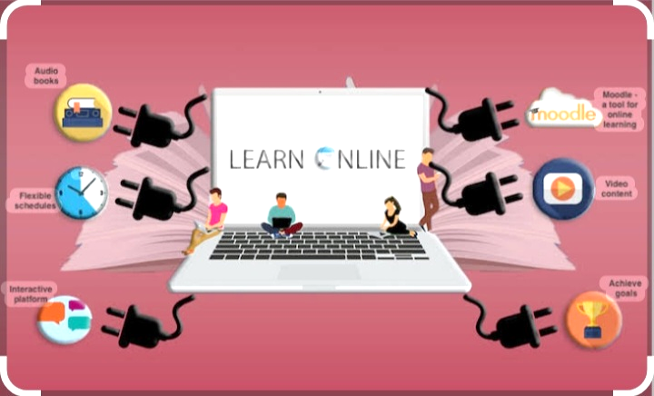
Student digital portfolio using future online education

Slide 3

agenda
1.Problem Statements
2.Project Overview
3. End Users
4.Tools and Technologies
5.Portfolio design and Layout
6.Features and Functionality
7.Results and Screenshots
8.Conclusion
9.Github Link

Slide 4

PROBLEM STATEMENT
Future online education faces problem statements like the digital divide(unequal access to technology and stable internet),lack of digital literacy among students and educators, insufficient infrastructure and resources, the challenge of maintaining student engagement and motivation, social isolation and a reduced sense of community, and potential negative health impacts from prolonged screen time.

Slide 5
Future Online Education faces ongoing problems with ensuring equitable digital access, bridging the digital skills gap for both students and educators, and maintaining effective pedagogy to foster engagement, especially in practical subjects and beyond traditional lectures.
Key issues also include preventing academic dishonesty, addressing student isolation and motivation, and overcoming infrastructural hurdles like unreliable internet connectivity

Slide 6

Project overview
The future of online education will be defined by increasing technological integration, offering highly personalized, flexible, and accessible learning experiences through AI, virtual and hybrid models that blend online and in person instruction. My Portfolio contain a HOME, ABOUT, PROJECTS, CONTACT.

Slide 7
Artificial intelligence(ai) :
ai Will personalize learning paths, provide Realtime feedback, automate administrate tasks, and identify knowledge gaps for individual learners.
VIRTUAL AND AUGMENTED REALITY(VR/AR) :
These immersive technologies will create interactive and engaging learning environments, making education more effective.

Slide 8

Who are the end users
The primary end users of future online education include working professionals seeking to upskill or reskill, students of all ages looking for flexibility and access to a wider range of courses, rural and underserved populations benefiting from increased accessibility, and lifelong learners of diverse backgrounds aiming to learn at their own pace.

Slide 9
UNDERGRADUATE AND GRADUATE STUDENTS:
The post-pandemic era saw a massive increase in online enrollment, and this trend is expected to continue as student seek flexibility and access to diverse programs without relocation.
WORKING PROFESSIONALS:
Professionals leverage online education to acquire new skills, stay current in rapidly evolving fields like IT, and advance their careers, fitting learning into their demanding schedules.

Slide 10

Tools and techniques
I am using a tools and techniques are HTML, CSS, and JavaScript. The HTML using to a text structure, pages, sections, heading. The CSS using a styling like colors, layout, text formatting.
The JavaScript using a hyperlinks like animations. I am using a code editor is VISUAL STUDIO.

Slide 11
Portfolio design and layout
Future online education portfolio design will likely be dynamic, multimedia, rich and highly personalized. They are including a sections are home, about, projects, contact. The portfolio layout responsive in desktop view.

Slide 12
DYNAMIC CONTENT:
Portfolios will move beyond static collections to become living documents that reflect ongoing learning, incorporating evolving projects, evolving skills, and new badges earned from reputable online learning platforms.
PERSONALIZATION:
Content will be tailored to specific career goals, showcasing practical applications and the skills relevant to the viewer’s needs.

Slide 13
Features and functionality
Future online education will feature greater personalization through AI and adaptive learning, enhanced interactivity and gamification, and increased flexibility and accessibility for a global audience.
Functionality will include user friendly interfaces, cloud hosted platforms, robust assessment tools, offline access to content, and advanced analytics to track student progress and improve learning experiences.

Slide 14
LIFELONG LEARNING SUPPORT:
Online education will be a cornerstone for continuous professional development, offering accessible and affordable courses that support career advancement and adaptability to future trends.
GAMIFICATION:
The integration of game-like elements and mechanics will be used to increases student motivation, engagement, and overall performance.

Slide 15
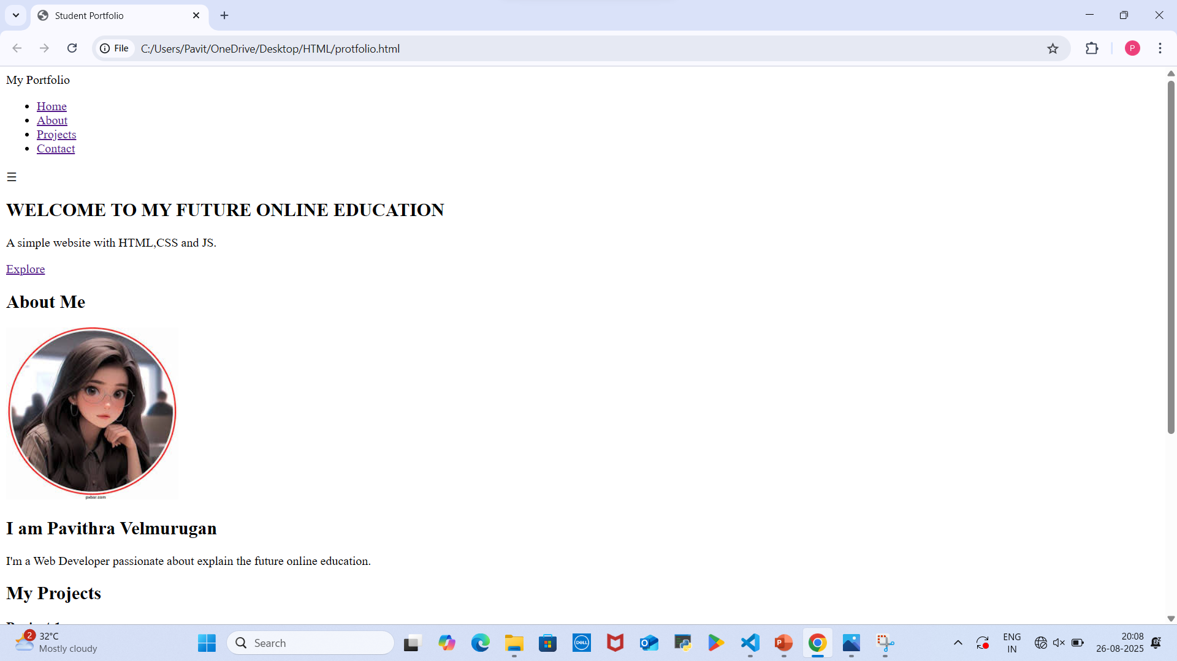
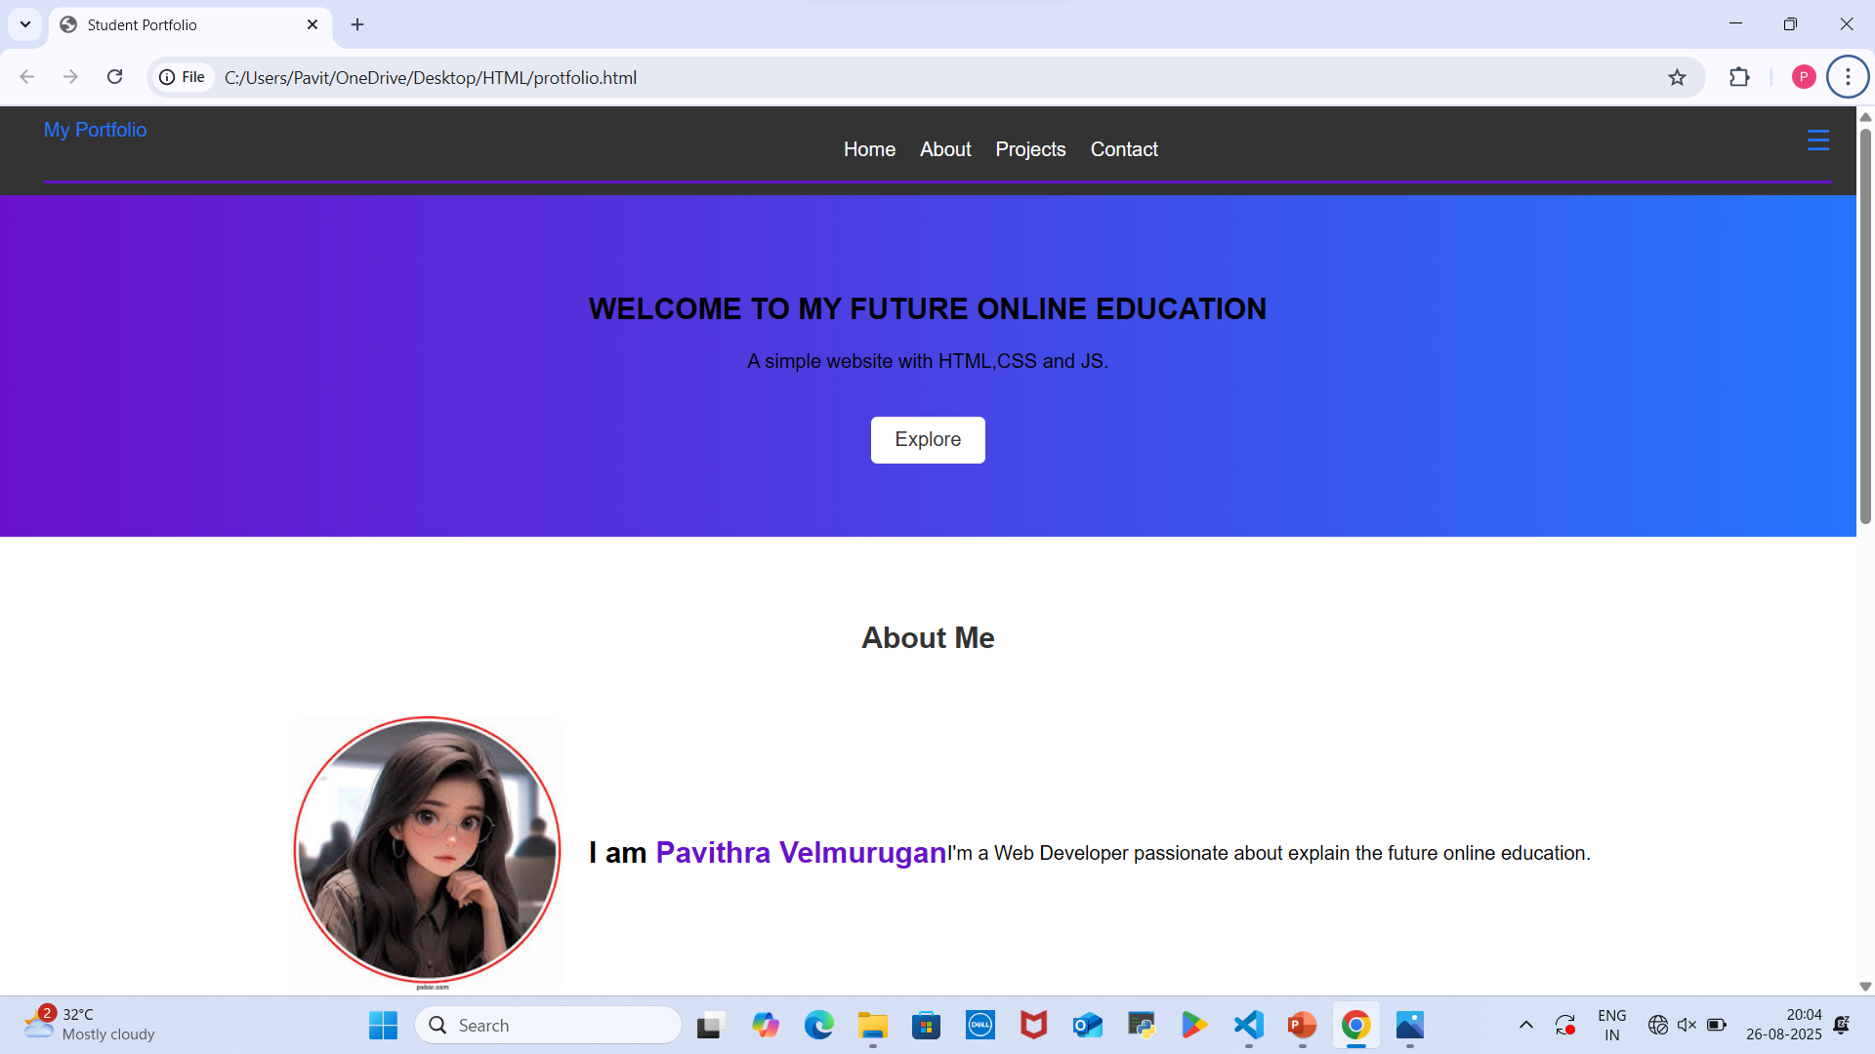
Results and screenshots.
Plain html
With css and js

Slide 16
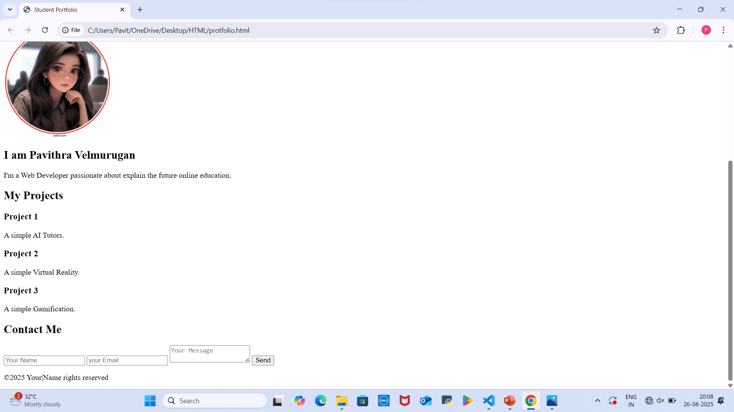
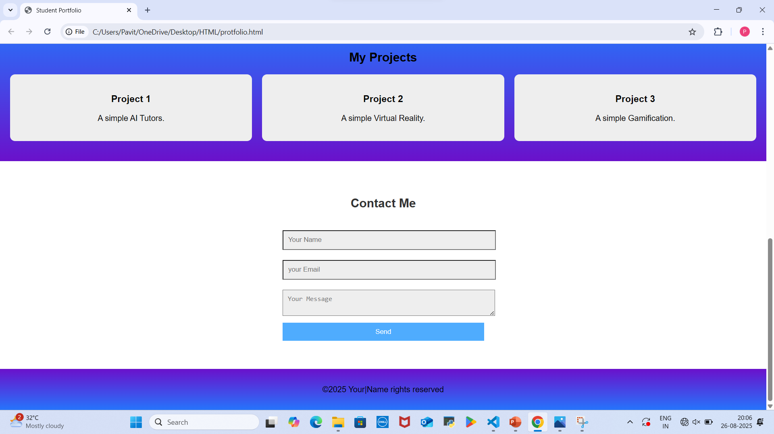
Plain html
With css and js

Slide 17
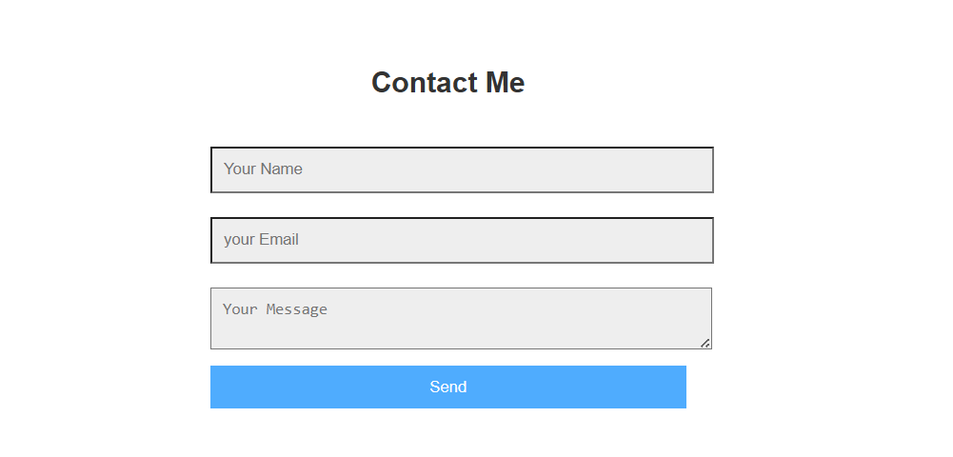
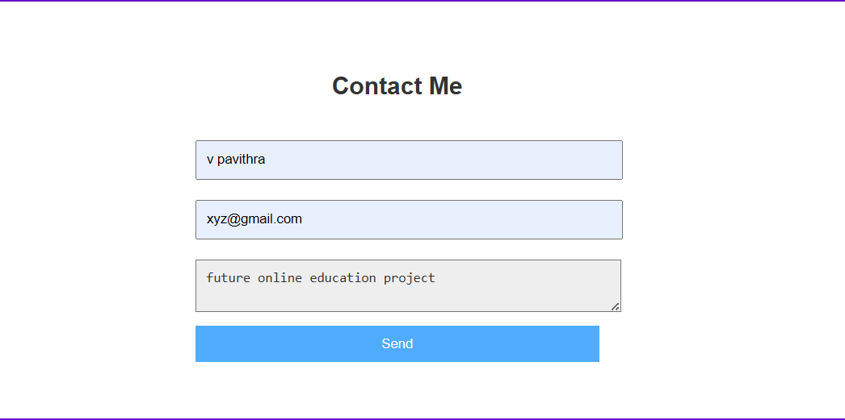
before
after

Slide 18
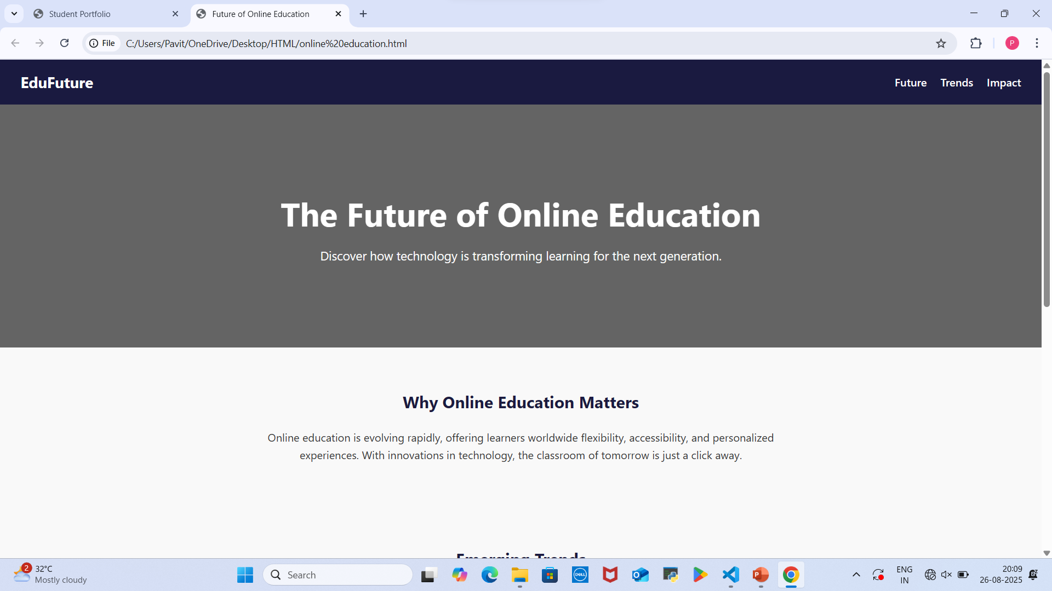
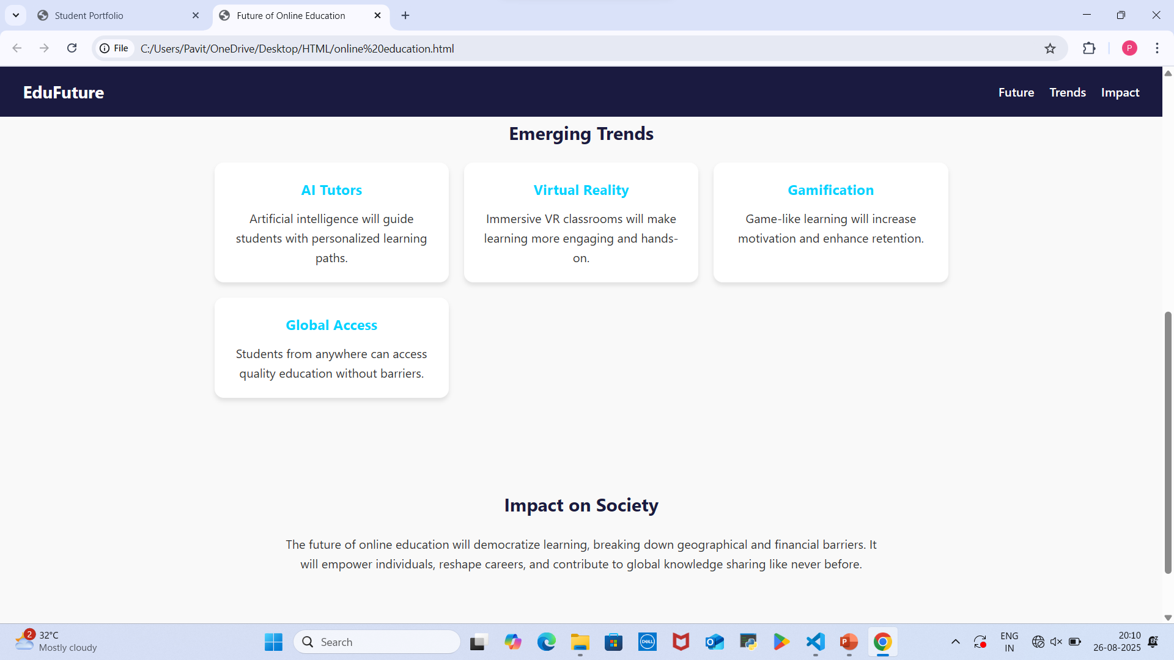
Future online education results.

Slide 19
conclusion
The Future of online education is a more personalized, interactive, and accessible learning landscape, driven by AI, VR, and AR, which will facilitate lifelong learning and skill development through flexible, hybrid, and micro-credentialed models.
Future online education benefits society by increasing accessibility and inclusivity to education, fostering lifelong learning through flexible. It also helps develop critical technical and self-discipline skills in learners.

Slide 20


